Slide 1
Detecting fraudulent health-insurance claims using data-driven methods
Jana Raed
Kareem Elfeel
Youssef Taha
Youssef Mazhar

Slide 2
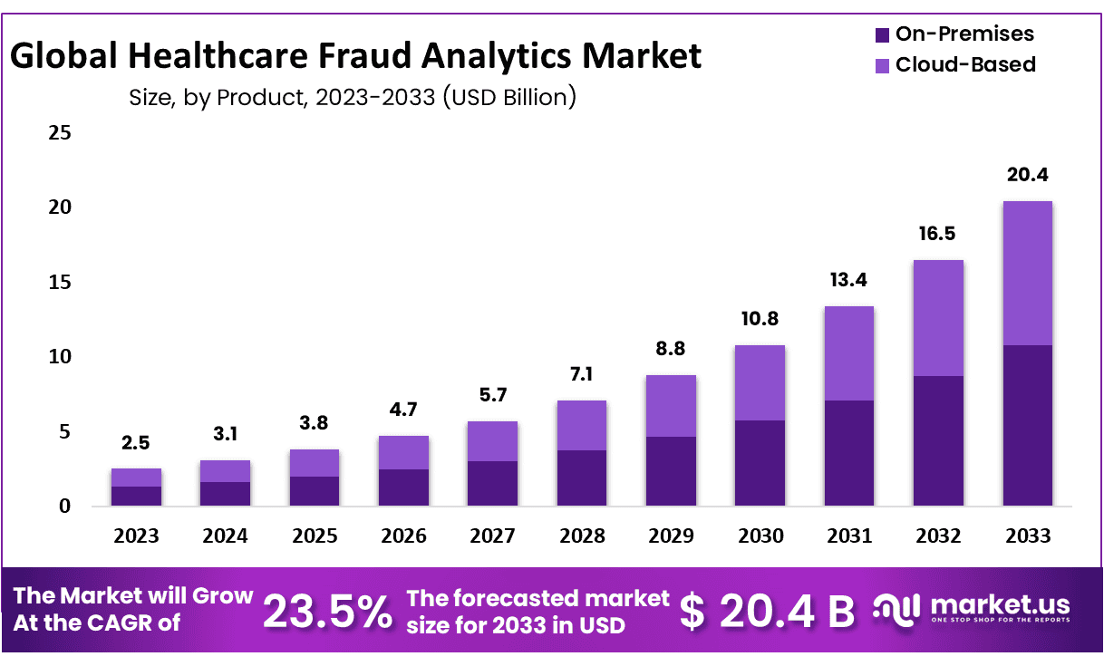
The Impact of Fraud on the Insurance Business
National Health Service(NHS) in the UK estimates that they are vulnerable to 1.346Billion worth of fraud each year.
Media Market a journal estimates that by 2033 the fraud on health insurance will rise to 20.4 Billion USD

Slide 3
Objective of the Project
Develop an intelligent, data-driven fraud detection system for Medicare.
Improve fraud detection beyond outdated rule-based systems that miss sophisticated schemes.
Protect the healthcare system from billions in financial losses.

Slide 4
Types of Healthcare Fraud
Billing for Services Not Provide | A clinic submits claims for 20 physical therapy sessions for a patient who only visited twice.
Upcoding | A clinic submits claims for 20 physical therapy sessions for a patient who only visited twice.
Unbundling | A provider bills three different lab tests separately instead of using the single “bundled” test code that includes all three.
Duplicate Billing | A clinic sends the same claim to the insurer twice—once electronically and once on paper.

Slide 5
Types of Data Used in the Project

Slide 6
Types of Data Used in the Project
Beneficiary
Information
Inpatient
Claims
Outpatient
Claims
Age, gender, place of residence
Chronic health conditions
Unique patient ID
Facility details
Admission and discharge dates
Procedures performed
Doctor visits
Tests (ex: Blood Tests)
Treatments

Slide 7
Analytical Approach
Analytical Approach
Analyzing the average bill across inpatient and outpatient
Analyzing abnormal frequency pattern
Comparing health issues to similar health issues bills
Billing patterns that do not match medical necessity

Slide 8
Types of Models to solve fraud insurance
Algorithm | Strategy | F1-Score | Precision | Recall | PR-AUC | ROC-AUC | Train_Time | FN | FP
Logistic Regression | SMOTE | 0.530769 | 0.375000 | 0.907895 | 0.651507 | 0.911797 | 2.339280 | 7 | 115
Decision Tree | Class Weights | 0.614525 | 0.533981 | 0.723684 | 0.597509 | 0.835723 | 0.225492 | 21 | 48
Random Forest | Class Weights | 0.714286 | 0.705128 | 0.723684 | 0.768034 | 0.965745 | 1.044055 | 21 | 23
XGBoost | Class Weights | 0.641975 | 0.604651 | 0.684211 | 0.779496 | 0.961260 | 0.994883 | 24 | 34
SVM | SMOTE | 0.571429 | 0.425806 | 0.868421 | 0.507729 | 0.931865 | 9.593154 | 10 | 89

Slide 9
Why Random Forest?
Highest Overall Test Performance
Random Forest Test Accuracy: 94.57%
Best balance of TP (55) and TN (712)
Lowest False Positive Rate: 3.13% → minimizes unnecessary investigations
Balanced Recall: 72.37% → captures most fraud while controlling costs

Slide 10
Why Random Forest?
Handles Highly Non-Linear Relationships
Robust to Noisy, Skewed, and High-Variance Data
Inherent Feature Importance Improves Explainability
Stable Results Across Multiple Training Runs

Slide 11
Reference
https://cfa.nhs.uk/
https://media.market.us/healthcare-fraud-analytics-market-news/

Slide 12

Thank You

